Slide 1

PathFinder
PathFinder
Christopher Costelloe K00233369, Kevin Dunne K00232599, Jekaterina Pavlenko K00224431
Chris Costelloe K00233369, Kevin Dunne K00232599, Jekaterina Pavlenko K00224431

Slide 2

Introduction
What is it?
An Indoor Navigation Application
Technologies involved?
Azure
Android
QR / Barcodes.
Target Audience?
Colleges
Hospitals
Airports
etc.

Slide 3

Background
Why we chose this project?
What is unique about it?
Low-cost/convenient
Simple to use, implement & maintain

Slide 4
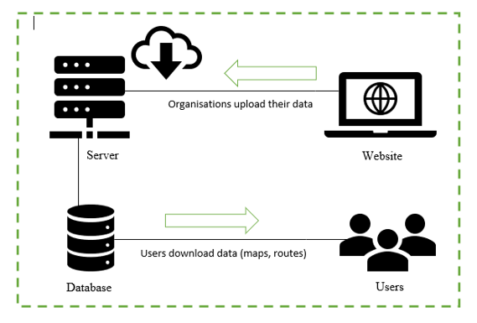
System Architecture
Azure Hosting for Web Hosting
RemoteMySQL for Database
Web Application
Android Mobile Application

Slide 5
Configuration
Web Application
Database design
Azure Hosting
RemoteMySQL
phpMyAdmin
Postman
Maps & Points Setup
Website
Android Application
SQLite
QR & Barcode
Building the path – Dijkstra’s Shortest Path algorithm

Slide 6
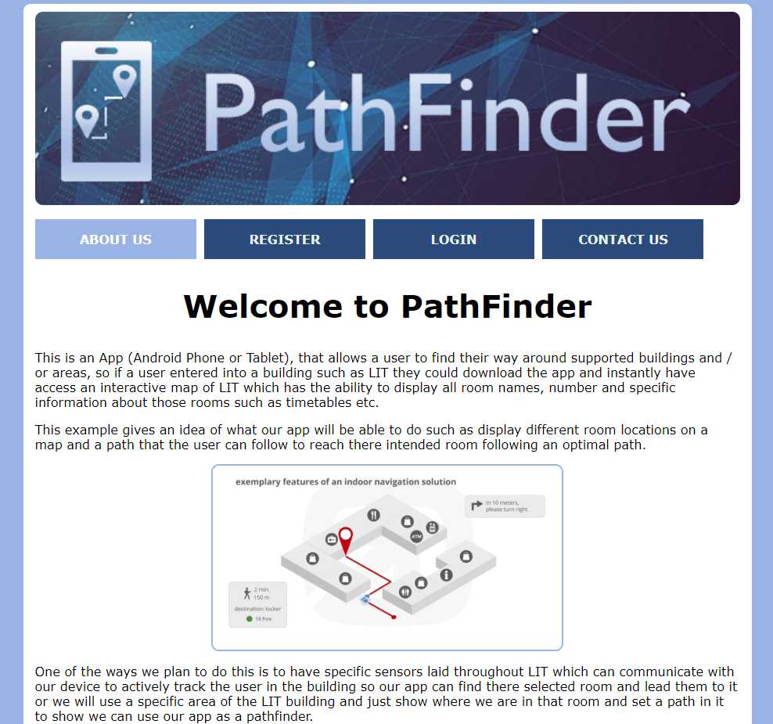
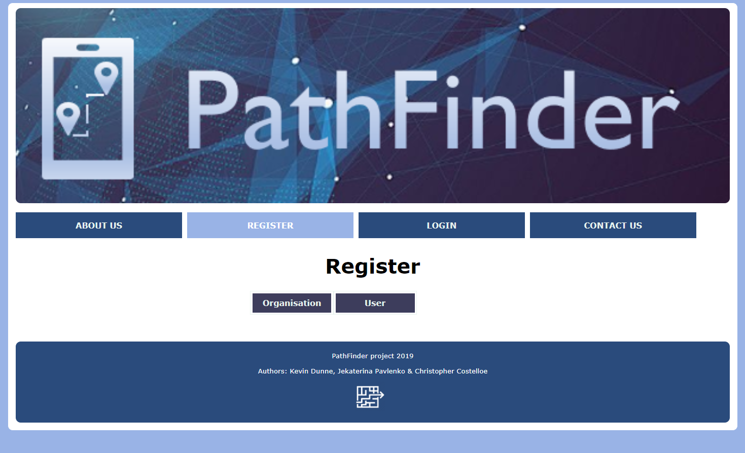
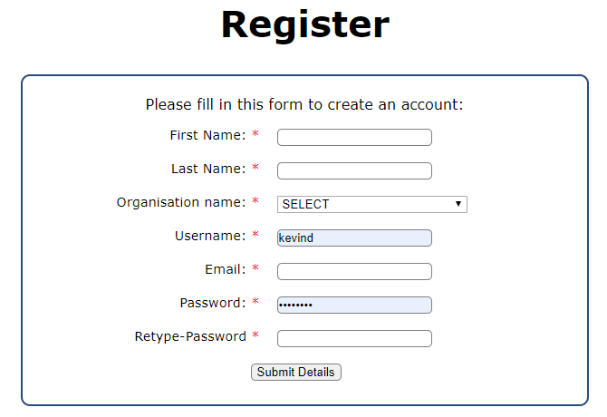
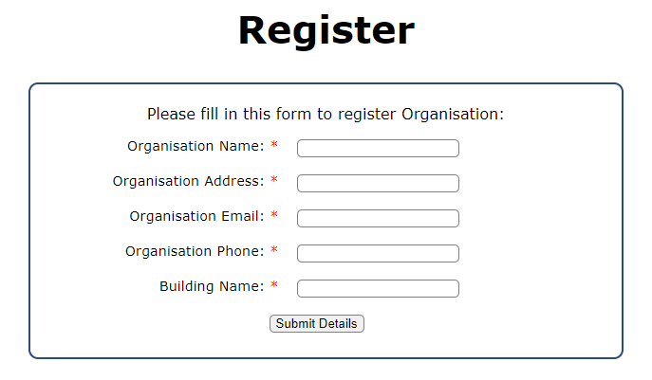
Web Application 1 - screenshots
1. Landing Page
2. Registration Org/User

Slide 7
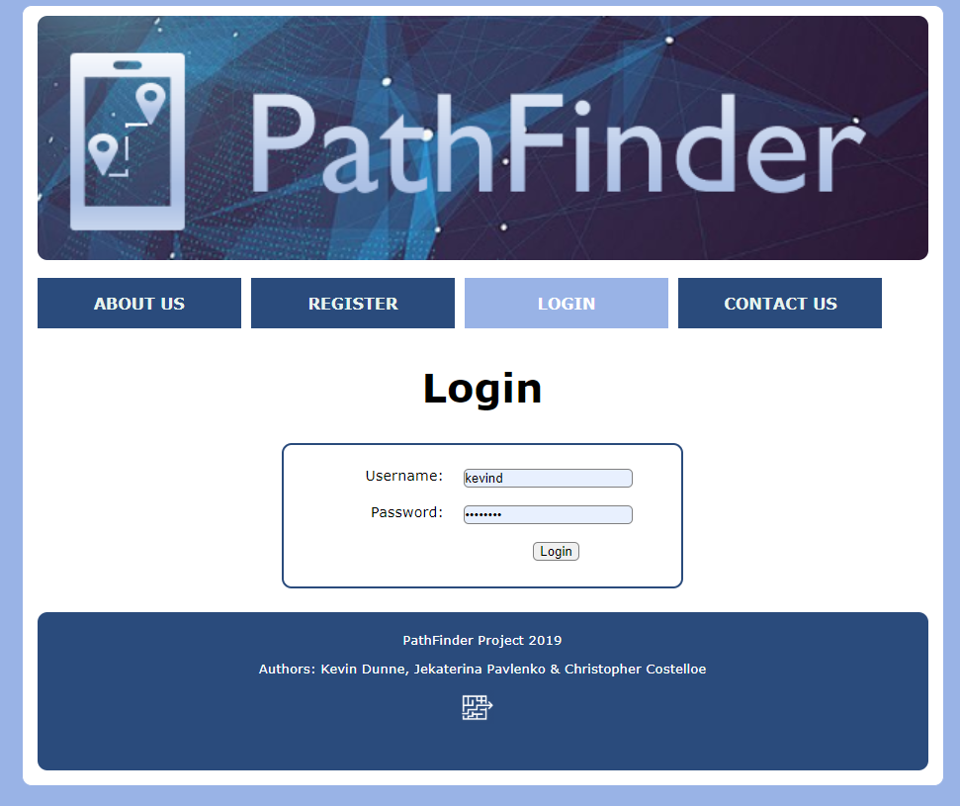
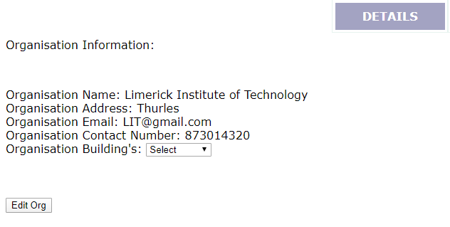
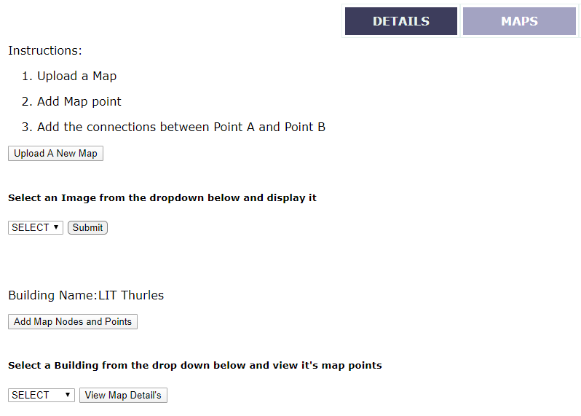
Web Application 2 - screenshots
3. Login Page
4. Details & Maps controls

Slide 8
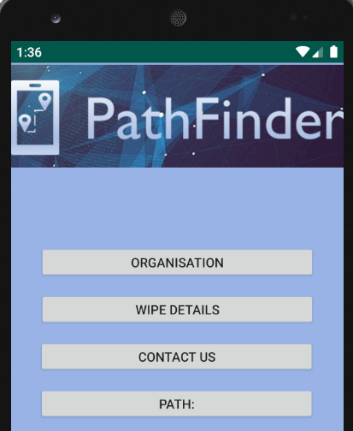
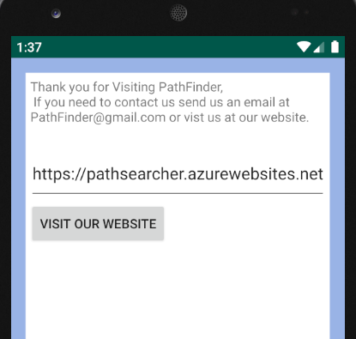
Android Application - screenshots
1. Home Screen
2. Contact Page

Slide 9
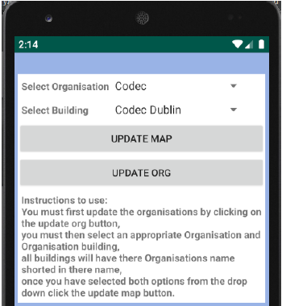
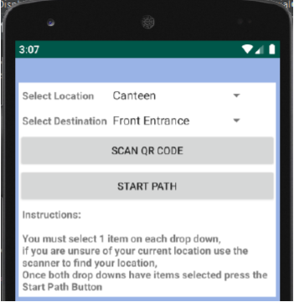
Android Application - screenshots
3. Functionality – maps/org update
4. QR Scanner/Path build

Slide 10
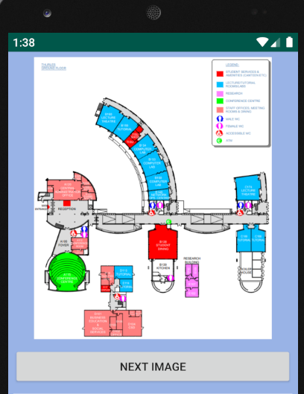
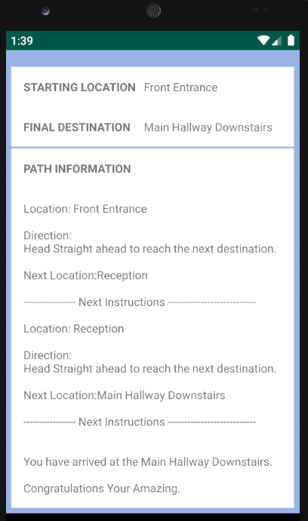
Android Application - screenshots
5. Map Of Building
6. Path displayed

Slide 11
Testing
Black-box
White-box
System Testing
Acceptance Testing
Integration Testing
Regression Testing
Iterative Testing
Unit Testing
Find the test case that will break the code

Slide 12
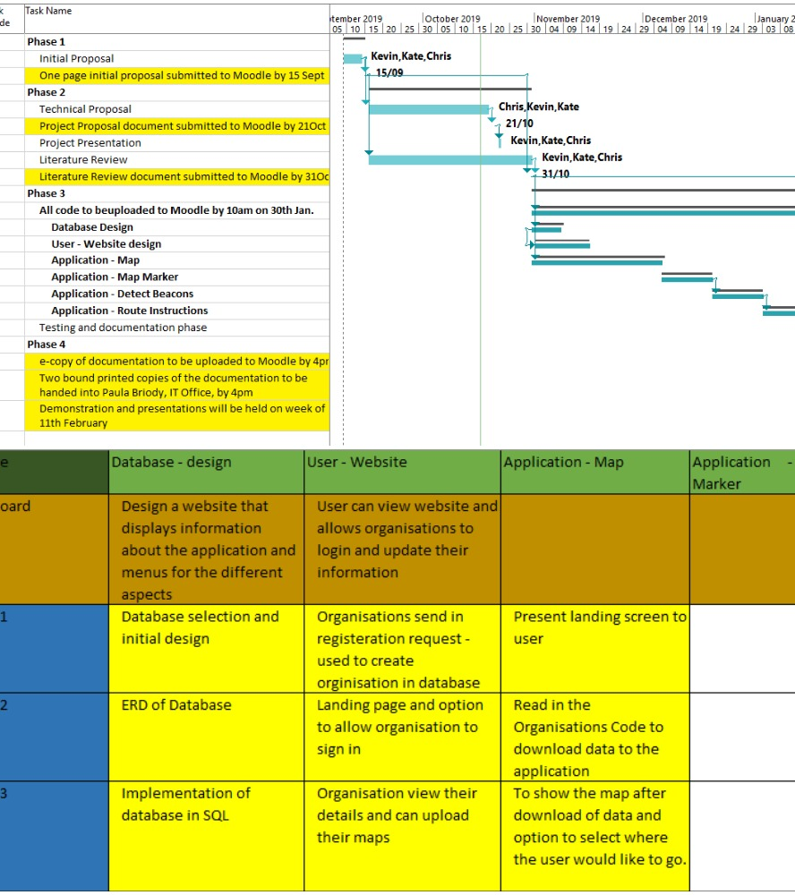
Project Management
Agile Methodology
Sprints
Gantt chart & backlog

Slide 13
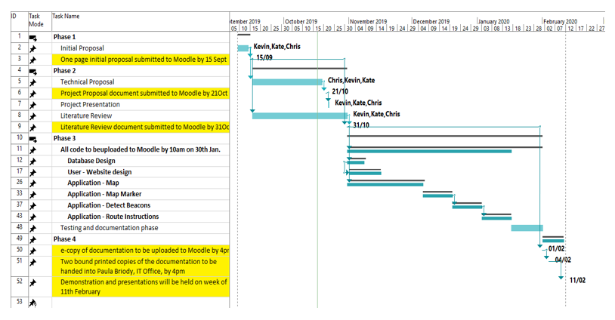
Gantt chart

Slide 14
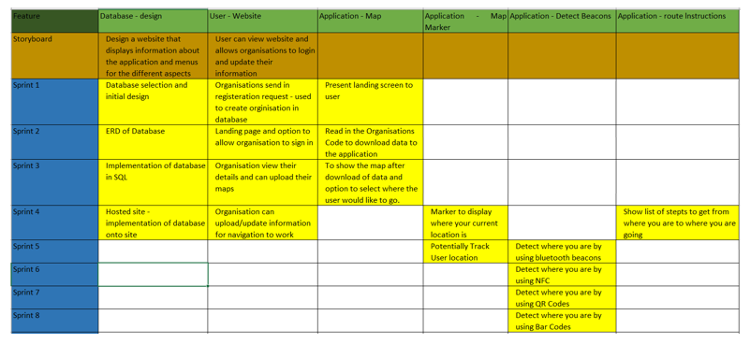
Sprints

Slide 15
Collaboration Tools:
List of what we are using:
GitHub
OneDrive
Messenger
Microsoft Office – Word, Excel etc.

Slide 16

Team Management
Meetings – Chairman, Scribe etc.
GitHub - updates
Problems & solutions
Achievements

Slide 17

THANK YOU

